Slide 1
Notes:
1
1

Slide 2
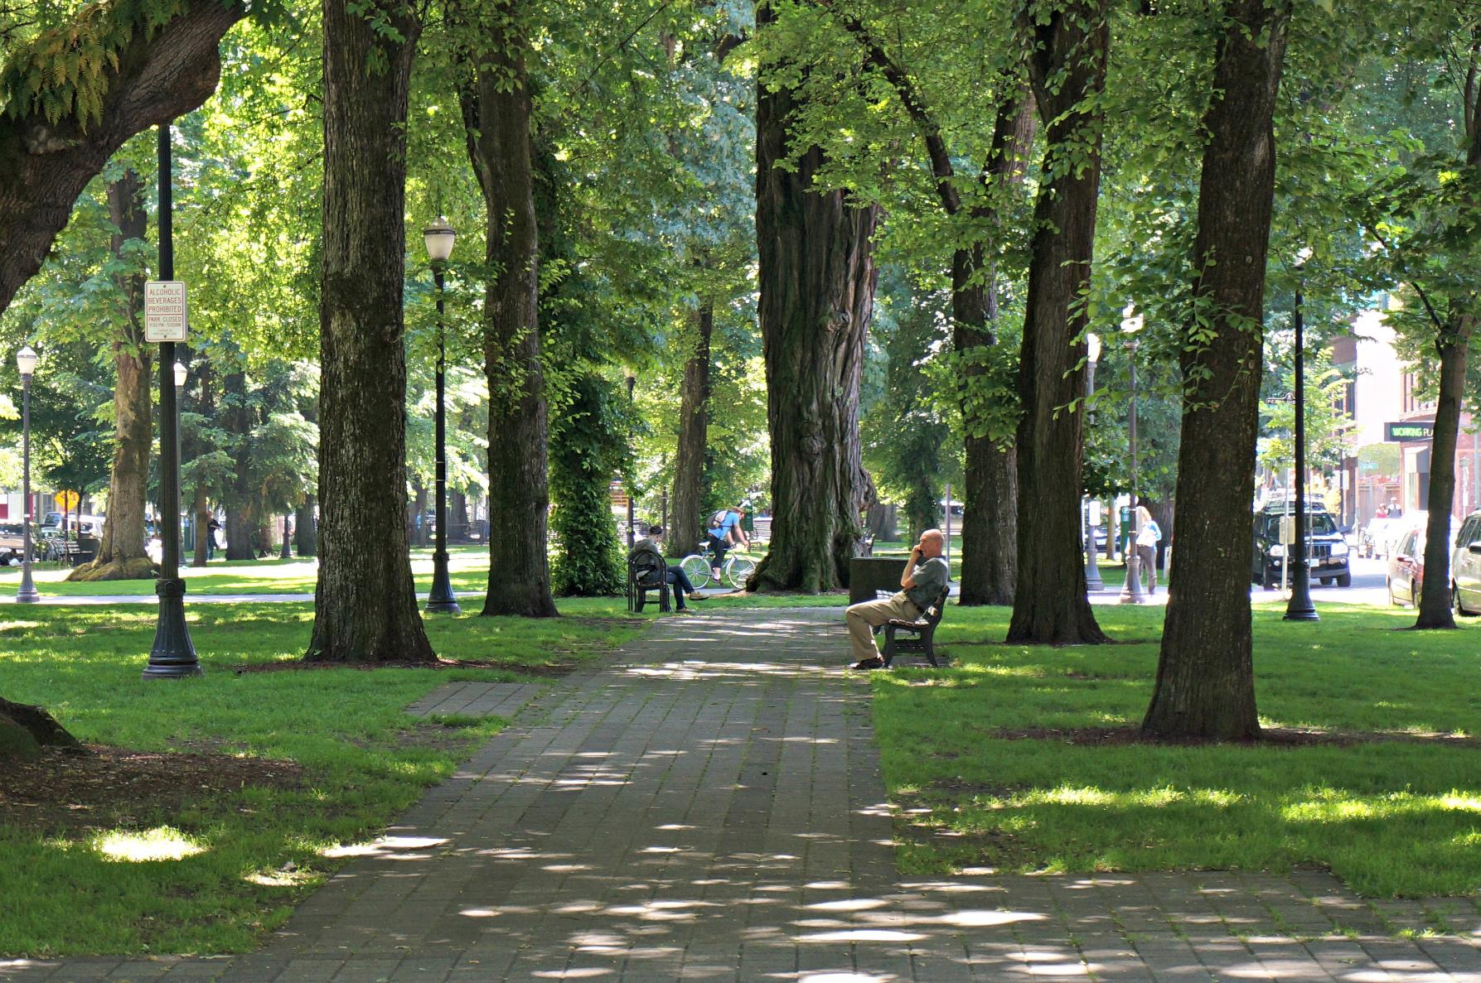
Tree Research and Education Endowment Fund
(TREE Fund) is a 501(c)3 non-profit organization that
supports scientific discovery and dissemination of new
knowledge in arboriculture and urban forestry.

Slide 3
TREE Fund has awarded nearly $4.0 million in grants since 2002 for:
Scientific research on urban trees
Education programs related to trees
Scholarships for aspiring tree care professionals

Slide 4
2018 TREE Fund Financial Highlights:
Awarded ten new research grants totaling ~$305,000
Paid ~$135,000 toward multi-year grants from prior years
Awarded seven scholarships totaling ~$35,000

Slide 5
2018 TREE Fund Community Engagement Highlights:
Offered six webinars with 2,500+ attendees
Published ten issues of TREE Press
Published three issues of Research Report
550+ guests at TREE Fund After Hours

Slide 6
Our 2018 Tour des Trees riders and teams raised over $340,000 to support new research awards, payments on prior multi-year grants, and future grants from the endowment

Slide 7
2019 Tour des Trees
2019 Tour des Trees
Tennessee – Kentucky loop, starting and ending in Nashville
Co-hosted by Southern and Kentucky Chapters of ISA
425+ miles in five days
Ride dates: September 16-20
Registration opens February 1st
Details at treefund.org/tourdestrees

Slide 8
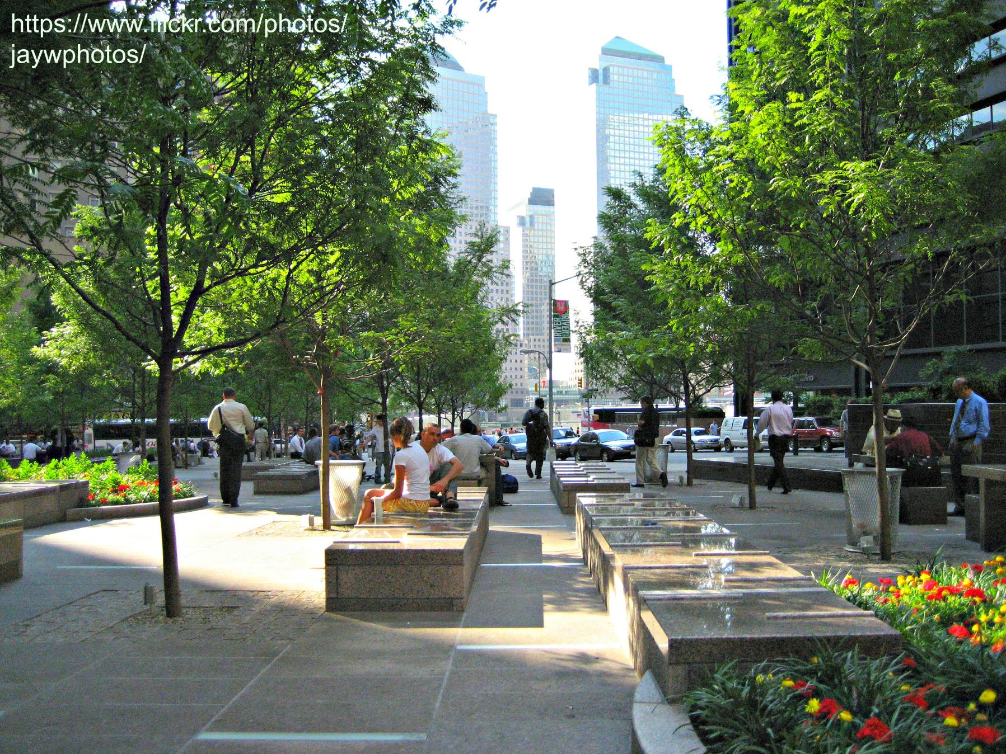
How can you help?
Participate in and promote our webinar series
Subscribe to TREE Press and share widely
Become a TREE Fund business partner or individual donor
Ride in or volunteer for the Tour des Trees

Slide 9
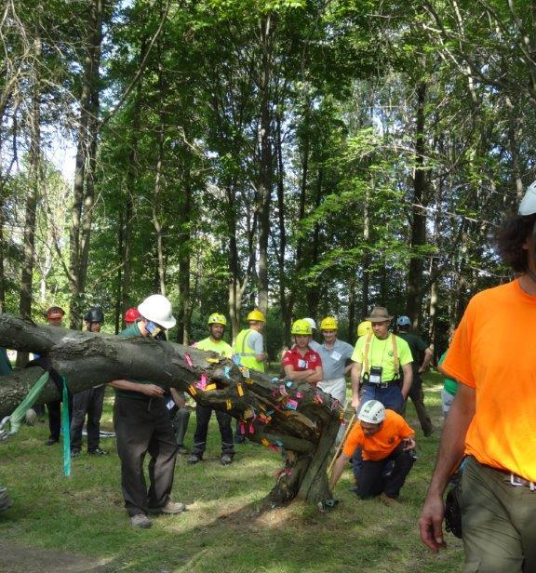
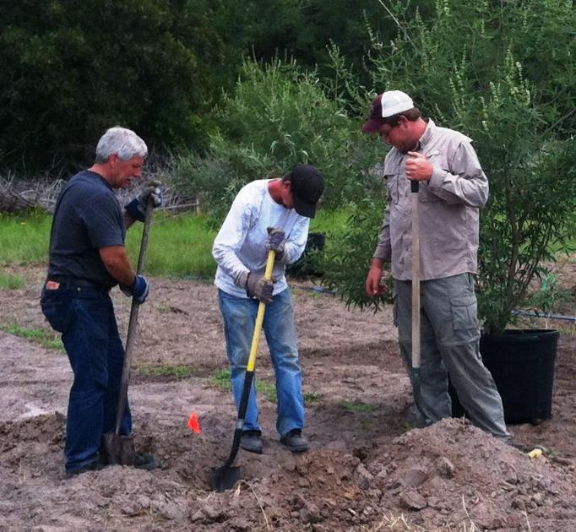
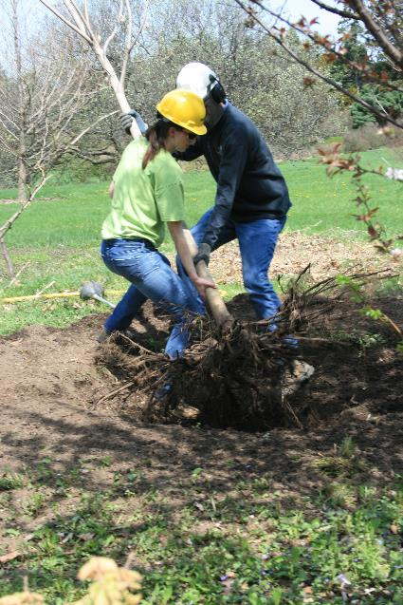
Thank you to our Crown and Diamond Partners
for their support and leadership
See treefund.org/partners for a complete list of our valued partners

