Slide 1



Slide 2
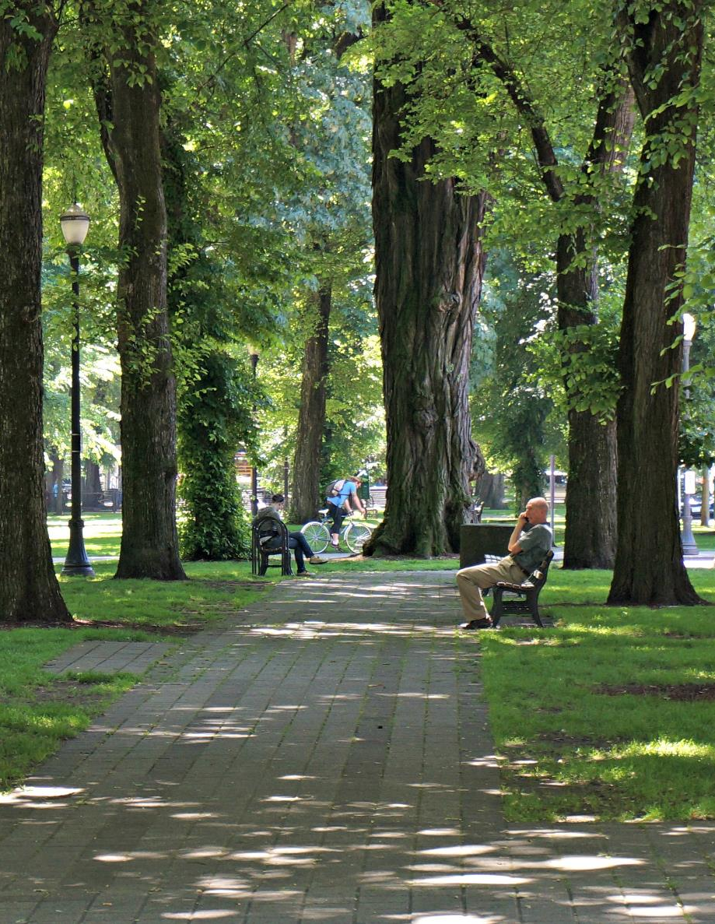
Tree Research and Education Endowment (TREE) Fund
TREE Fund is a 501(c)3 nonprofit organization that supports scientific discovery and dissemination of new knowledge in arboriculture and urban forestry.

Slide 3

TREE Fund Grant Awards
TREE Fund has awarded nearly $4.0 million in grants since 2002 for:
  Scientific research on urban trees
  Education programs related to trees
  Scholarships for aspiring tree care professionals

Slide 4

2018 TREE Fund Financial Highlights
Awarded ten new research grants totaling ~$305,000
Paid ~$135,000 toward multi-year grants from prior years
Awarded seven scholarships totaling ~$35,000

Slide 5

2018 TREE Fund Community Engagement Highlights
Offered six webinars with 2,500+ attendees
Published ten issues of TREE Press
Published three issues of Research Report
550+ guests at TREE Fund After Hours

Slide 6

2018 Tour des Trees
Our 2018 Tour des Trees riders and teams raised over $340,000 to support new research awards, payments on prior multi-year grants, and future grants from the endowment.

Slide 7

2019 Tour des Trees
Tennessee – Kentucky loop, starting and ending in Nashville
Co-hosted by Southern and Kentucky Chapters of ISA
425+ miles in five days
Ride Dates: September 16-20
Details at treefund.org/tourdestrees

Slide 8

How can you help?
Participate in and promote our webinar series
Subscribe to TREE Press and share widely
Become a TREE Fund business partner or individual donor
Register to ride in or volunteer for the 2019 Tour des Trees

Slide 9


Slide 10
