Slide 1
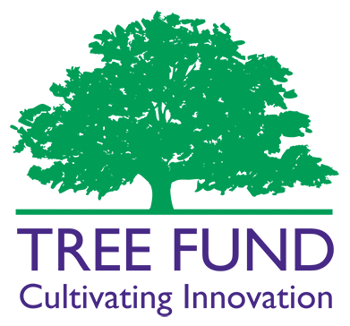
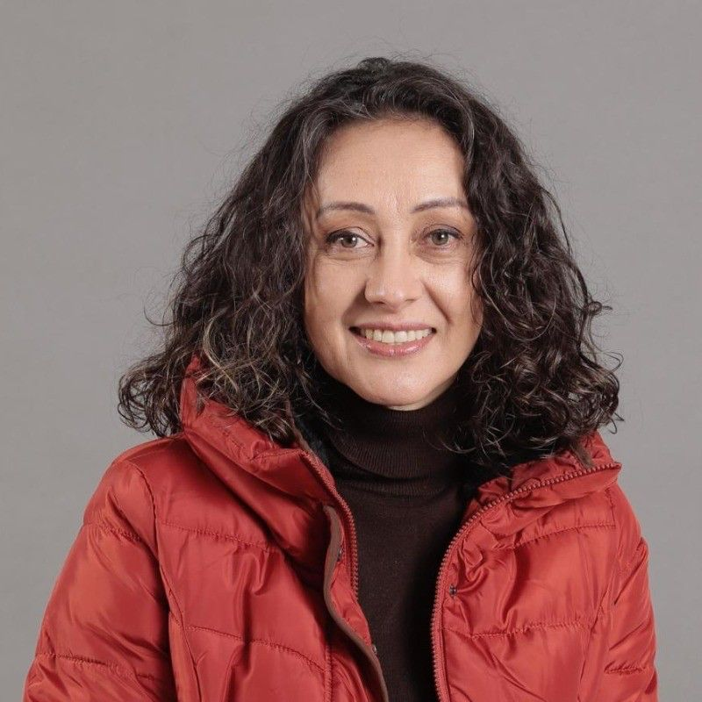



FUND REPORT 2025
RESEARCH GRANT
Bob Skiera Memorial Fund Building Bridges Initiative Grant Program
The Initiative is intended to help arborists and urban foresters communicate the value of trees and urban forests through engagement via collaborative research and other projects with public works officials, risk assessment professionals, civil engineers, wildlife researchers, soil scientists and others. The maximum award value of grants under the Building Bridges Initiative is $30,000, with $25,000 provided annually by the Bob Skiera Memorial Fund and $5,000 provided annually by the John White Memorial Fund.
TOTAL DONATIONS
AWARDEE DETAILS
January 1 – December 31, 2025: $3,676.82
Gifts over $500
- Dave Scharfenberger
- First Choice Lawn Care, LLC
- Gary Johnson
Urban trees are fundamental to public health and resilience in Medellín, Colombia, a city internationally recognized for its innovations in urban greening yet where unequal access persists. While some sectors boast consolidated tree canopy coverage, Comuna 4- a densely populated and vulnerable neighborhood- remains disproportionately exposed to high levels of PM2.5 pollution and solar radiation, conditions that exacerbate respiratory illnesses, heat stress and environmental inequities.
This transdisciplinary project employs participatory design to co-develop priorities, communication tools, and demonstrative enhancements that highlight the fundamental role of trees as living infrastructure. Our integrated approach encompasses: 1.environmental modeling of PM2.5 and solar radiation to generate robust, site-specific evidence on tree-associated benefits; 2.GIS-based analysis of ecological connectivity to map tree canopy gaps and identify opportunities for strengthening tree networks; and 3.citizen perception studies and participatory workshops in Comuna 4 to capture local knowledge, build legitimacy and guide priority-setting.
The project will culminate in the selection and adaptation of a pre-existing green space in Comuna 4 which will function as a living classroom to communicate in situ how trees mitigate urban thermal stress and to provide visible examples for decision-makers, professionals, and community members. The overarching objectives are to: produce site-specific evidence on the health and climate benefits of trees; translate this evidence into transferable tools, guides, and visuals for arborists, developers, engineers, urban planners, and policymakers; demonstrate community-driven approaches that inspire future investments in equitable tree planting and strengthen the capacity of arborists and urban foresters to communicate effectively with professionals and decision-makers.
AWARDED IN 2025
The Bob Skiera Memorial Fund Building Bridges Initiative and John P. White Grant was awarded to Luz Piedad Romero Duque of Fundación Jardín Botánico “Joaquín Antonio Uribe” de Medellín (Colombia), for the project, “Beyond the Ca: Cocreating a Healthier City with Urban Trees.” for $30,000
APPLICATIONS
34 applications were received for this grant during the 2025 Fall Grant Application Cycle.
ADDITIONAL REPORTS
2023 Recipient, JD Brown finished his project - https://treefund.org/archives/23154
2023 Recipient, JD Brown and Tim Beatley presented during TREE Fund Webinar Series - https://youtu.be/dEanWs9X-yE in October 2025 with 1,225 people in attendance.
2020 Recipient, Mysha Clark, PhD, and Stephanie Cadaval presented during TREE Fund Webinar Series - https://www.youtube.com/watch?v=UalSAZrkZH0 in May 2025 with 1,003 people in attendance
2021 and 2019 recipients, Lindsay Darling and Jason Gordon, presented in a TREE Fund Webinar Series as a panel, in partnership with American Forests, https://www.youtube.com/watch?v=9-8va0qklEs in July 2025 with 790 people in attendance
Tree Research and Education Endowment Fund
treefund.org
treefund@treefund.org

